Slide 1
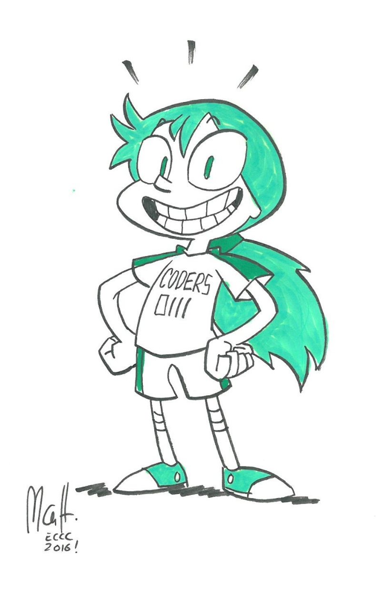
Comicall
Randy Burgess
Max Cartwright
Andrea Thomas

Slide 2
The world of comics is overwhelming!
With COUNTLESS titles available, it can be hard to navigate toward YOUR preferred comics
ComiCall is a clean, age-friendly app that is most useful for people interested in searching by characters, titles, and publishers
Why waste time doing Google searches that send seekers down rabbit hole after rabbit hole when ComiCall can simplify queries, save comics of interest, and even search for the nearest comic shops?
Call on ComiCall for comic searches big AND small!

Slide 3
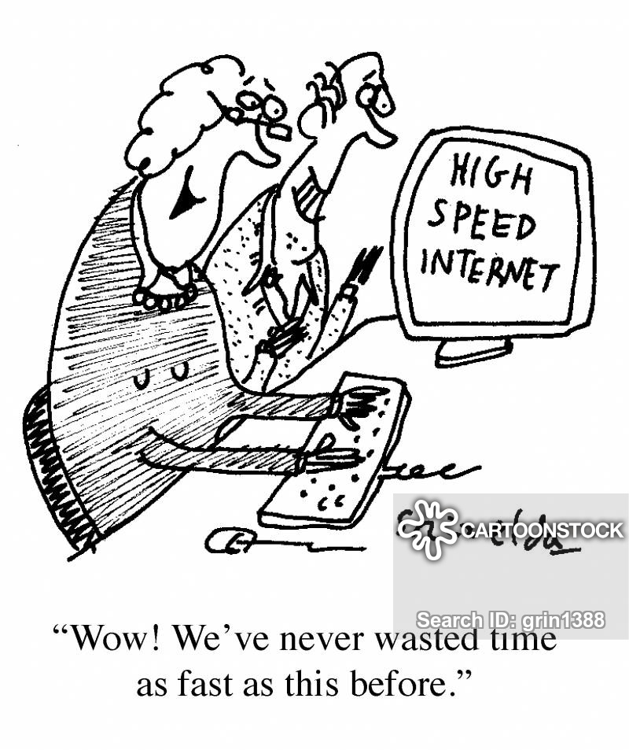
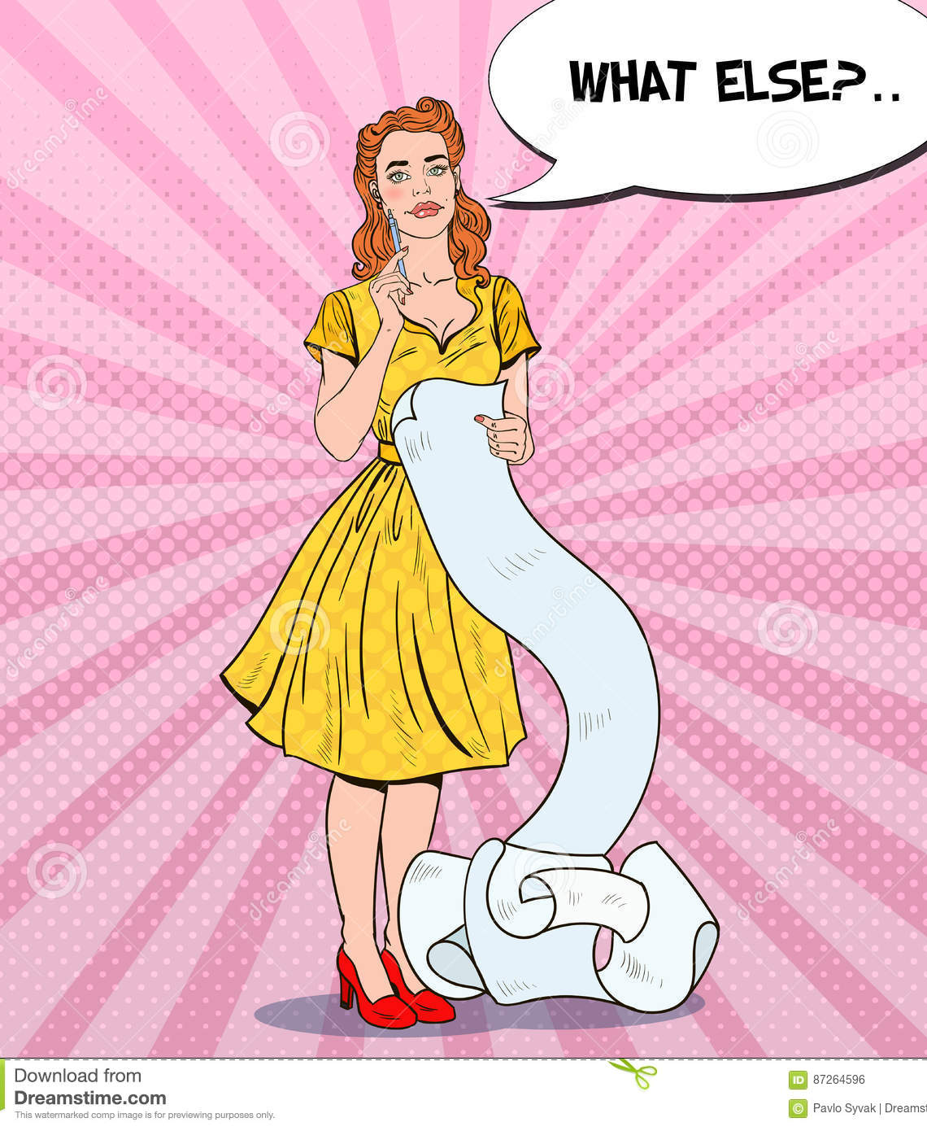
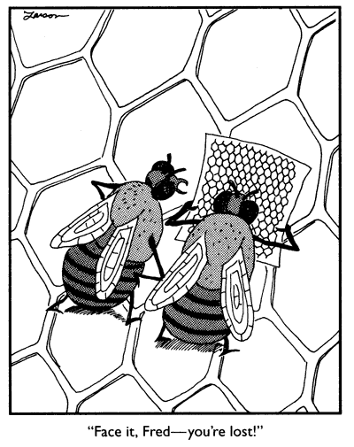
User story As a user, I would like to…
Browse for comics
Create a wish list
Find a comic shop
by character or title
of the comics that catch my interest
located near me

Slide 4


where did our motivation come from?
This
Not this

Slide 5

Find Comicall via:
https://maximilianc88.github.io/ComiCall/
AND
https://github.com/maximilianc88/ComiCall

Slide 6
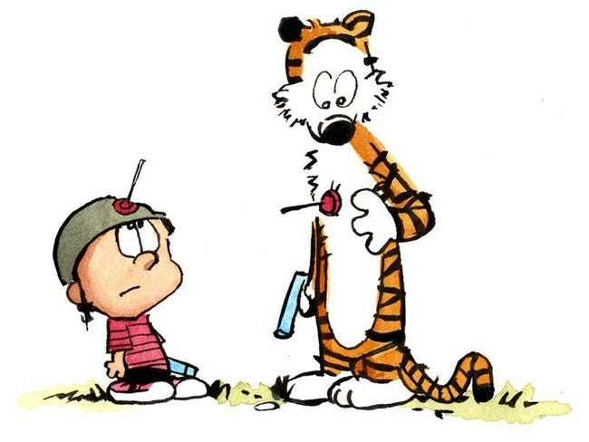
“They aren’t roadblocks. They’re signposts.” Richie Norton (whoever that is)
Paper CSS Framework
Inline styling galore (not ideal)
Paper CSS stylesheet download, investigating, and overriding
Comic Vine API
Incomplete API
Inaccurate documentation
Giphy API
Obscure, off-point Superhero and Villain gif returns

Slide 7
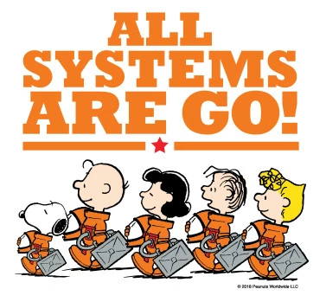
What Worked for us as a team?
Regular stand-ups
Utilizing partner-coding
Video chats
Divided up front-end tasks
Pseudocoding (white boards)
Back-end planned together
Broke early
Asked for help

Slide 8
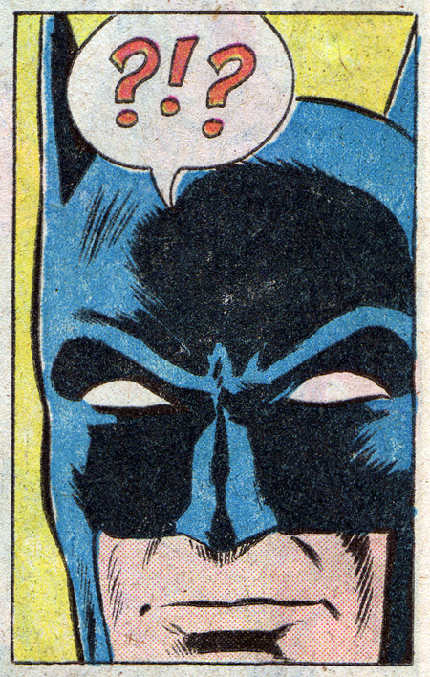
What Did We learn?
Planning phase = incredibly important
Research API
Front-end = less hands in the kitchen is best
Execution phase = incredible important
Break early and often
Source in the console
Postman
Work-arounds for APIs
Focus on our MVP (minimum viable product)
Prioritized realistic features
Git-ing it done

Slide 9



Any Questions?

